Slide 1

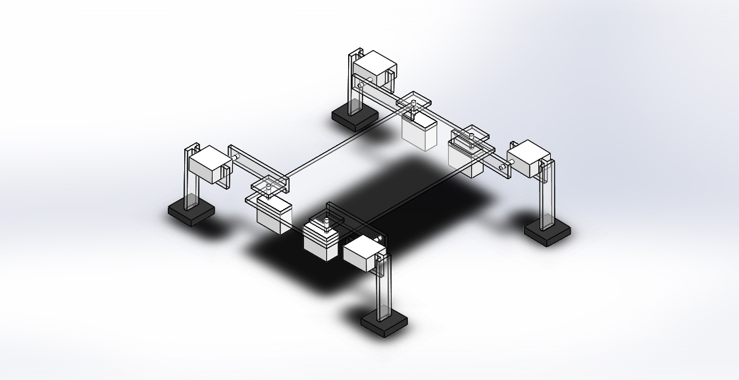
Locomotion AND PATH PLANNING of Quadruped legged robot
PRESENTED BY:
Ashish Agrawala
Krishna Agrawal
Shubham p. gothale

Slide 2
Contents
1, Past work and objective
2. Inverse Kinematics
DH parameters
Matlab program
Block Diagram
Attempt 1
Attempt 2
Attempt 3
Attempt 4

Slide 3
Past work
Performed various static and dynamic gait diagrams .
objective
Development of inverse kinematics model of the leg.

Slide 4
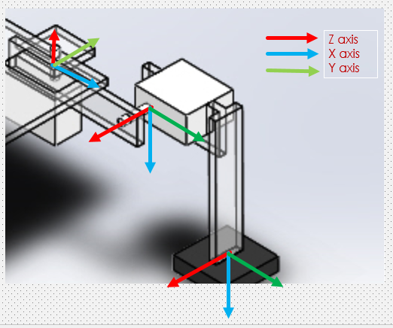
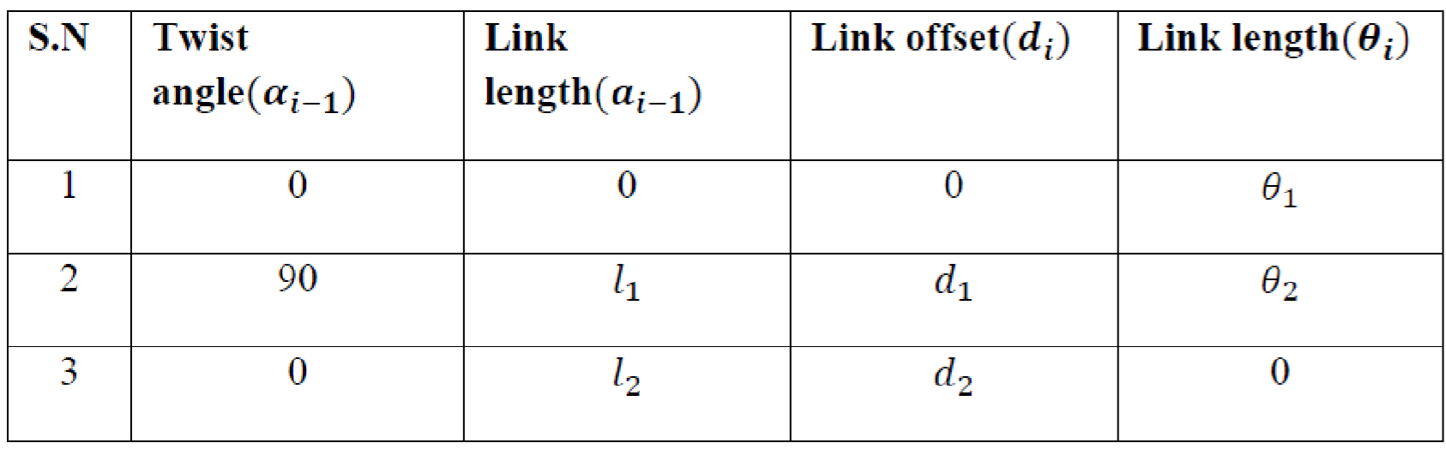
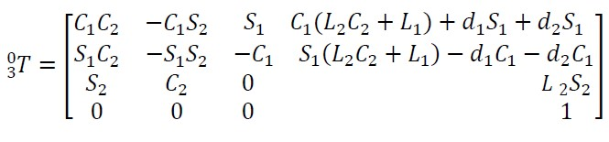
Inverse kinematics
DH Parameters:

Slide 5
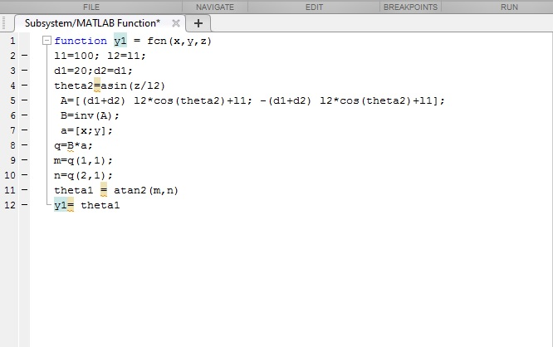
Matlab Program:

Slide 6
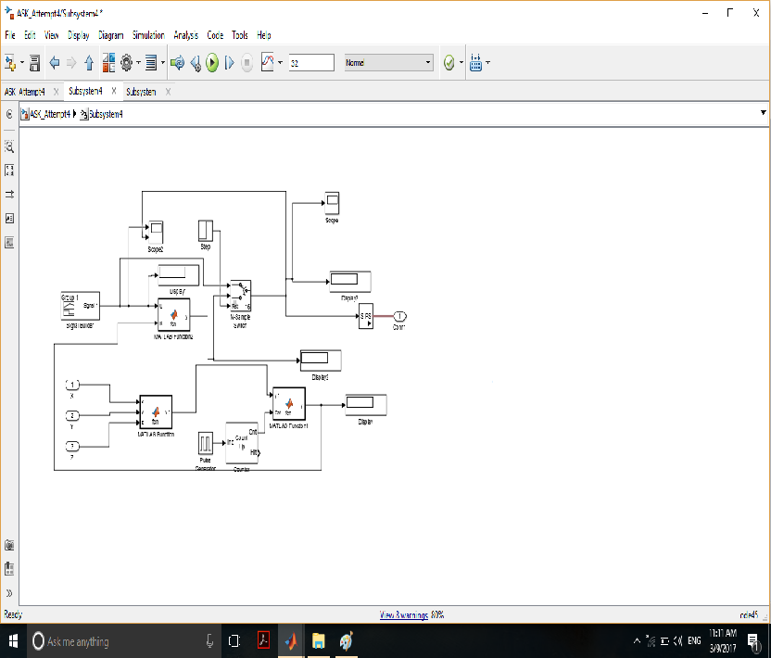
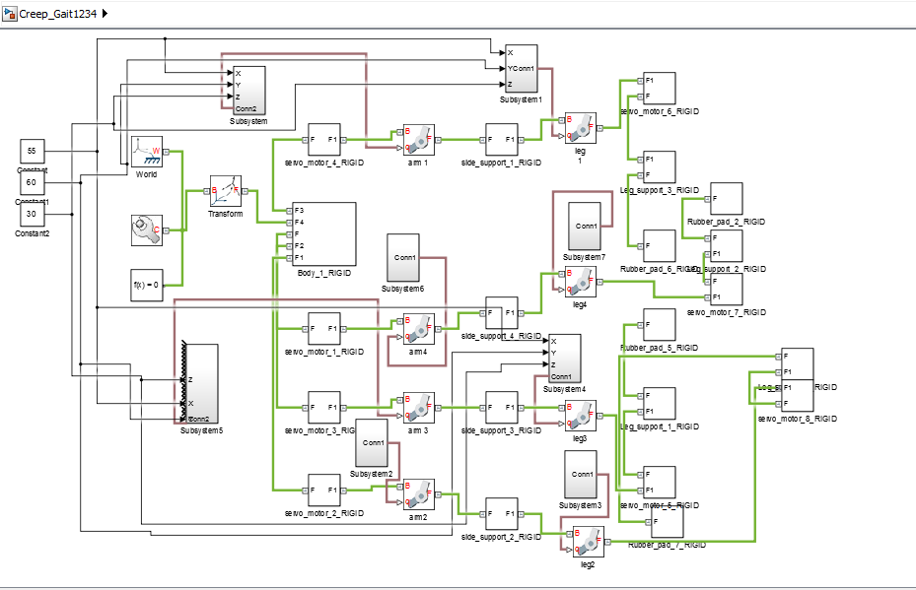
Block Diagram

Slide 7
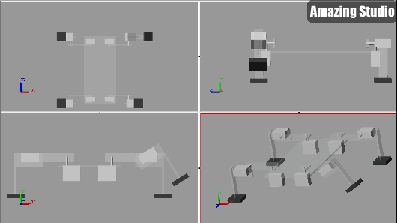
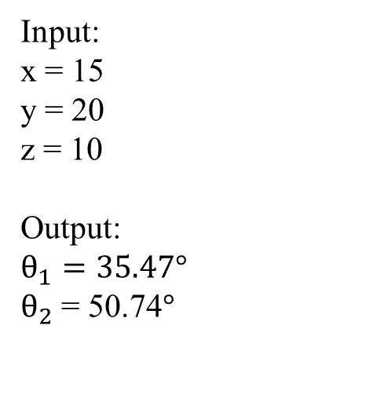
Attempt 1:
Input:
x = 15
y = 20
z = 10
Output:
$$θ_{1}=35.47°$$
$θ_{2}$ = 50.74$°$

Slide 8
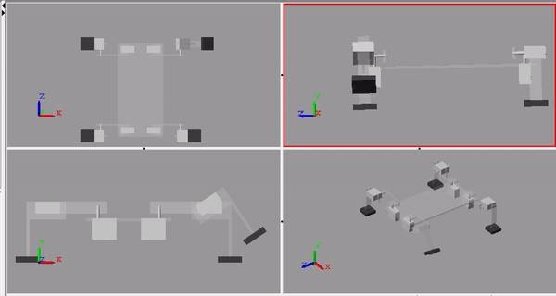
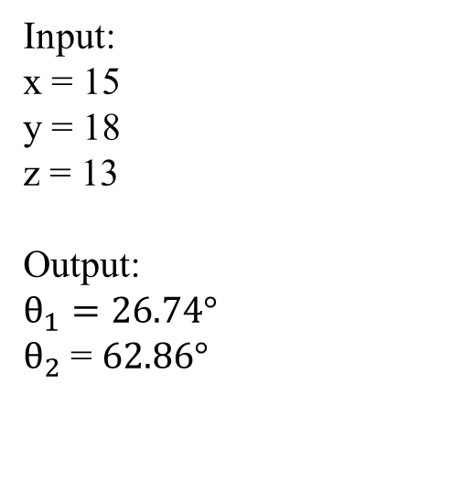
Attempt 2:
Input:
x = 15
y = 18
z = 13
Output:
$$θ_{1}=26.74°$$
$θ_{2}$ = $62.86°$

Slide 9
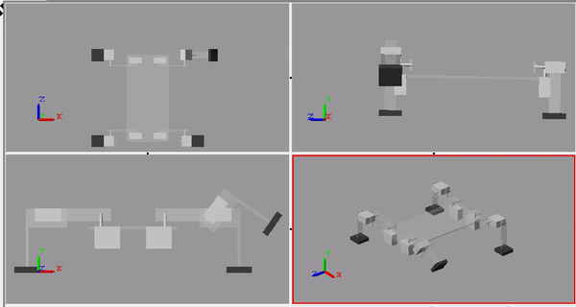
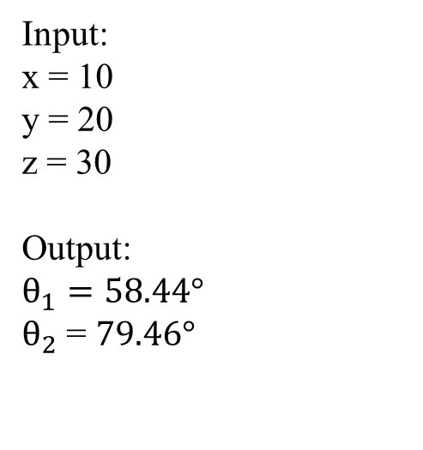
Attempt 3:
Input:
x = 10
y = 20
z = 30
Output:
$$θ_{1}=58.44°$$
$θ_{2}$ = $79.46°$
9

Slide 10
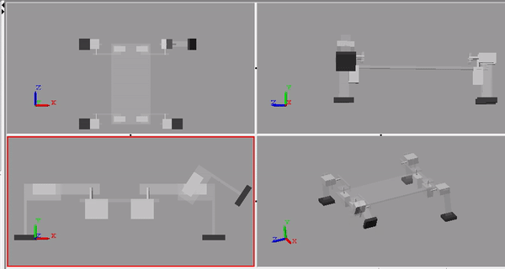
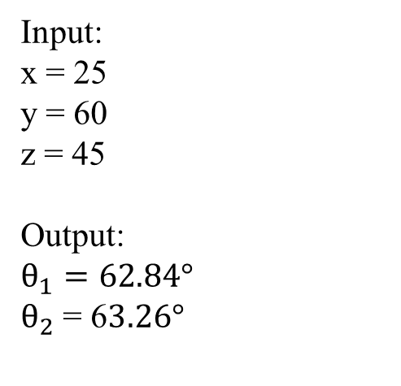
Attempt 4:
Input:
x = 25
y = 60
z = 45
Output:
$$θ_{1}=62.84°$$
$θ_{2}$ = 6$3.26°$
10

Slide 11


